Slide 1
PRESENTATION ON LIDAR BASED SELF DRIVING CAR
Main Project-Phase 1
BY
Risheek D S 1NH19EC412
Vasu V B 1NH18EC115
Prashanth B 1NH18EC088
Rahul M 1NH18EC143
Guided By
Dr. Piruthiviraj P
Associate Professor
Dept. of ECE
New Horizon College of Engineering, Bengaluru

Slide 2
Content
Introduction
Literature Review
Existing System
Problem Statement
Proposed System
Block Diagram
Hardware & Software Specification
Working Model
Conclusion

Slide 3
Introduction
LiDAR stands for “Light Detection and Ranging” and describes a sensor technology that can create a map of the environment around it.
We have designed an automated vehicle that is focused to give automated driving experience to the human driver.
This car is capable of sensing the surroundings, navigating and fulfilling the human transportation capabilities without any human input.
Lidar is used for sensing the surroundings.

Slide 4
Today we use LIDAR in automotive and self-driving vehicles
use, but one of the popular use-cases of LIDAR was archeology
for mapping the large scale of land.LIDAR, a detection sensor
which works on principle of radar, but uses light from a laser
Why did LIDAR take off with self-driving cars? In a word:
mapping. LIDAR allows you to generate huge 3D maps (its
original application), which you can then navigate the car or robot
predictably within.

Slide 5
Literature Review
Article | Architecture / Methodology used | Features and Research claims
Scalability in Perception for Autonomous Driving: Waymo Open Dataset[19] | It is 15x more diverse than the largest camera+LiDAR dataset available based on our proposed diversity metric. | Provide strong baselines for 2D as well as 3D detection and tracking tasks.
Pseudo-LiDAR From Visual Depth Estimation: Bridging the Gap in 3D Object Detection for Autonomous Driving[20] | convert image-based depth maps to pseudo-LiDAR representations essentially mimicking the LiDAR signal. With this representation we can apply different existing LiDAR-based detection algorithms | Improvements over the existing state-of-the-art in image-based performance raising the detection accuracy of objects within the 30m range from the previous state-of-the-art of 22% to an unprecedented 74%.
Towards Robust LiDAR-based Perception in Autonomous driving.[21] | LiDAR-based perception is vulnerable to spoofing attacks, in which adversaries spoof a fake vehicle in front of a victim self-driving car by strategically transmitting laser signals to the victim's LiDAR sensor. | General architecture for robust LiDAR-based perception, and propose SVF that embeds the neglected physical features into end-to-end learning. SVF further reduces the mean attack success rate to around 2.3%.
Sparse LiDAR and Stereo Fusion (SLS-Fusion) for Depth Estimationand 3D Object Detection.[22] | From 2D to 3D object detection, the most difficult is to determine the distance from the ego-vehicle to objects. Expensive technology like LiDAR can provide a precise and accurate depth information, so most studies have tended to focus on this sensor showing a performance gap between LiDAR-based methods and camera-based methods. | Through evaluation on the KITTI benchmark, it is shown that the proposed method significantly improves depth estimation performance compared to a baseline method.

Slide 6
Existing system
In self-driving cars, RADAR is a very common sensor. Companies like Tesla or Comma.ai use RADARs coupled with cameras to insure a vision-only system that couldn’t be possible without it.
Other manufacturers use the RADAR coupled with LiDARs and Cameras to get an awesome sensor fusion module. When used in the context of autonomous driving, the RADAR is a great complementary sensor that can solve other sensors’ weaknesses.
To sum up the picture, RADARs can measure the velocity of an object directly and can work during different scenarios such as day, night, rain, fog, snow… while other sensors may be troubled. It works by emitting electromagnetic (EM) waves that reflect when they meet an obstacle. Since it works using EM waves, it can work under any condition.

Slide 7
Problem Statement
Moreover, some roads and streets are simply unmarked, presenting quite an issue for driverless cars. In addition to lane marking problems, the lack of uniformity in road signage and stoplights could also prove to be a hurdle for autonomous car technology

Slide 8
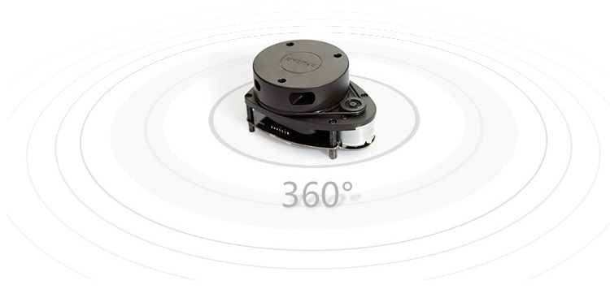
Proposed System
When LIDAR emits, laser beam it moves vertically up and down due to the height of lidar and angle of lidar movement (360degrees and vertical), it gives data from 4 to 6m from lidar placed.
To get the correct distance of obstacle, measured dimension of vehicle is added with the data of lidar.

Slide 9
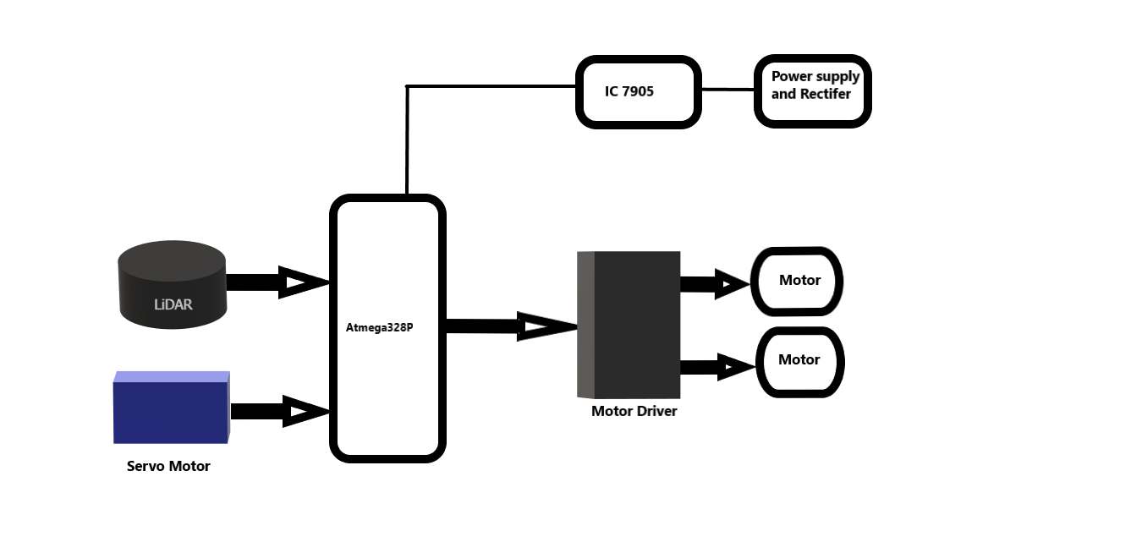
Block Diagram

Slide 10
Hardware & Software Specification
Software Used:-
Arduino IDE
Proteus Design Suite
SLAMTEC RoboStudio
Hardware Used:-
LiDAR
AtMega328P
Motor driver
Servo Motor
Dc motors
Resistors
Capacitors
Transistors Cables and Connectors Diodes
PCB and Breadboards
LED
Transformer/Adapter
Push Buttons
Switch
IC Sockets

Slide 11
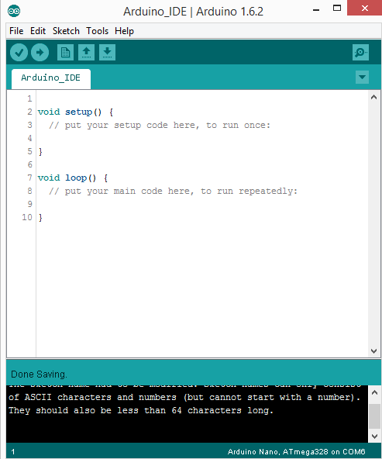
Arduino IDE
Arduino is an open-source prototyping stage which is based on simple to-utilize hardware and programming.
Arduino sheets can read inputs - buzzer on a sensor, a finger on a button, or any message - and transform it into an output - initiating an engine, turning on a LED, publishing something on the web.
You can guide your board by sending an arrangement of instructions to the microcontroller on the board. To do as such you need the Arduino programming language, and the Arduino Software (IDE), based on Processing.

Slide 12
// This sketch code is based on the RPLIDAR driver library provided by RoboPeak
#include <RPLidar.h>
#include <SoftwareSerial.h>
#include <Servo.h>
#include <SoftPWM.h>
// You need to create an driver instance
RPLidar lidar;
//const int in4 = 9;
//const int in3 = 10;
//const int in2 = A0;
//const int in1 = A1;
const int motor_pin4 = 9;
const int motor_pin3 = 10;
const int motor_pin2 = A0;
const int motor_pin1 = A1;
const int buzzer = 8;
const int servo_pin = 11;
Servo myservo; // create servo object to control a servo
#define home_position 60//perfect
#define RPLIDAR_MOTOR 3 // The PWM pin for control the speed of RPLIDAR's motor.
// This pin should connected with the RPLIDAR's MOTOCTRL signal
bool round_bit = 0;
float angle, distance;
float prev_angle;
float angle_difference = 0;
SoftwareSerial transmitter(4, 7); // RX, TX---------------Tx of controller
int angle_changed_counter = 0;
int OneTimeVaribale = 0;
void setup() {
// bind the RPLIDAR driver to the arduino hardware serial
transmitter.begin(9600);
// transmitter.println("Start");
// set pin modes
pinMode(RPLIDAR_MOTOR, OUTPUT);
// pinMode(in4, OUTPUT);
// pinMode(in3, OUTPUT);
// pinMode(in2, OUTPUT);
// pinMode(in1, OUTPUT);
SoftPWMBegin();
SoftPWMSet(motor_pin1, 0);
SoftPWMSet(motor_pin2, 0);
SoftPWMSet(motor_pin3, 0);
SoftPWMSet(motor_pin4, 0);
SoftPWMSetFadeTime(motor_pin1, 0, 0);
SoftPWMSetFadeTime(motor_pin2, 0, 0);
SoftPWMSetFadeTime(motor_pin3, 0, 0);
SoftPWMSetFadeTime(motor_pin4, 0, 0);
pinMode(buzzer, OUTPUT);
digitalWrite(buzzer, LOW);
// digitalWrite(in4, HIGH);
// digitalWrite(in3, HIGH);
// digitalWrite(in2, HIGH);
// digitalWrite(in1, HIGH);
myservo.attach(servo_pin);
myservo.write(home_position);
delay(1000);
myservo.detach();
lidar.begin(Serial);
}

Slide 13
void loop() {
if (IS_OK(lidar.waitPoint())) {
distance = lidar.getCurrentPoint().distance; //distance value in mm unit
angle = lidar.getCurrentPoint().angle; //analog value in degree
bool startBit = lidar.getCurrentPoint().startBit; //whether this point is belong to a new scan
byte quality = lidar.getCurrentPoint().quality; //quality of the current measurement
}
else
{
analogWrite(RPLIDAR_MOTOR, 0); //stop the rplidar motor
// try to detect RPLIDAR...
rplidar_response_device_info_t info;
if (IS_OK(lidar.getDeviceInfo(info, 100)))
{
// detected...
lidar.startScan();
// start motor rotating at max allowed speed
analogWrite(RPLIDAR_MOTOR, 255);
delay(1000);
}
}
digitalWrite(buzzer, LOW);
forward();
// if ((distance > 145.00 and distance < 500.00) and (angle > 140.00 and angle < 211.00))//below 135mm lidar cant sense object properly //this is the border angles of actual used vehicle--Adjust if vehicle changed
if ((distance > 145.00 and distance < 300.00) and (angle > 130.00 and angle < 180.00))//below 135mm lidar cant sense object properly //this is the border angles of actual used vehicle--Adjust if vehicle changed
{
myservo.attach(servo_pin);
myservo.write(20);
LEFT();
delay(50);
// transmitter.print("deected-------------");
}
else if ((distance > 145.00 and distance < 300.00) and (angle > 180.00 and angle < 221.00))//below 135mm lidar cant sense object properly //this is the border angles of actual used vehicle--Adjust if vehicle changed
{
myservo.attach(servo_pin);
myservo.write(90);
RIGHT();
delay(50);
// transmitter.print("deected-------------");
}
else
{
digitalWrite(buzzer, HIGH);
myservo.attach(servo_pin);
myservo.write(home_position);
}
// transmitter.print("angle ");
// transmitter.println(angle);
// transmitter.print("distance ");
// transmitter.println(distance);
}
//
//void backward()
//{
// digitalWrite(m11, LOW);
// digitalWrite(m12, HIGH);
// digitalWrite(m21, LOW);
// digitalWrite(m22, HIGH);
//}
//void forward()
//{
// digitalWrite(in4, HIGH);
// digitalWrite(in3, LOW);
// digitalWrite(in2, HIGH);
// digitalWrite(in1, LOW);
//}
//void LEFT()
//{
// digitalWrite(in4, LOW);
// digitalWrite(in3, HIGH);
// digitalWrite(in2, HIGH);
// digitalWrite(in1, LOW);
//}

Slide 14
//void RIGHT()
//{
// digitalWrite(in4, HIGH);
// digitalWrite(in3, LOW);
// digitalWrite(in2, LOW);
// digitalWrite(in1, HIGH);
//}
//void Stop()
//{
// digitalWrite(in4, LOW);
// digitalWrite(in3, LOW);
// digitalWrite(in2, LOW);
// digitalWrite(in1, LOW);
//}
void forward()
{
SoftPWMSet(motor_pin4, 128);
SoftPWMSet(motor_pin3, 0);
SoftPWMSet(motor_pin2, 128);
SoftPWMSet(motor_pin1, 0);
// digitalWrite(in4, HIGH);
// digitalWrite(in3, LOW);
// digitalWrite(in2, HIGH);
// digitalWrite(in1, LOW);
}
void LEFT()
{
SoftPWMSet(motor_pin4, 0);
SoftPWMSet(motor_pin3, 254);
SoftPWMSet(motor_pin2, 254);
SoftPWMSet(motor_pin1, 0);
// digitalWrite(in4, LOW);
// digitalWrite(in3, HIGH);
// digitalWrite(in2, HIGH);
// digitalWrite(in1, LOW);
}
void RIGHT()
{
SoftPWMSet(motor_pin4, 254);
SoftPWMSet(motor_pin3, 0);
SoftPWMSet(motor_pin2, 0);
SoftPWMSet(motor_pin1, 254);
// digitalWrite(in4, HIGH);
// digitalWrite(in3, LOW);
// digitalWrite(in2, LOW);
// digitalWrite(in1, HIGH);
}

Slide 15
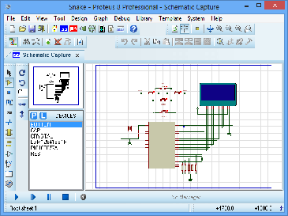
Protues Design Suite
The Proteus Design Suite is a proprietary software tool suite used primarily for electronic design automation.
The software is used mainly by electronic design engineers and technicians to create schematics and electronic prints for manufacturing printed circuit boards.

Slide 16
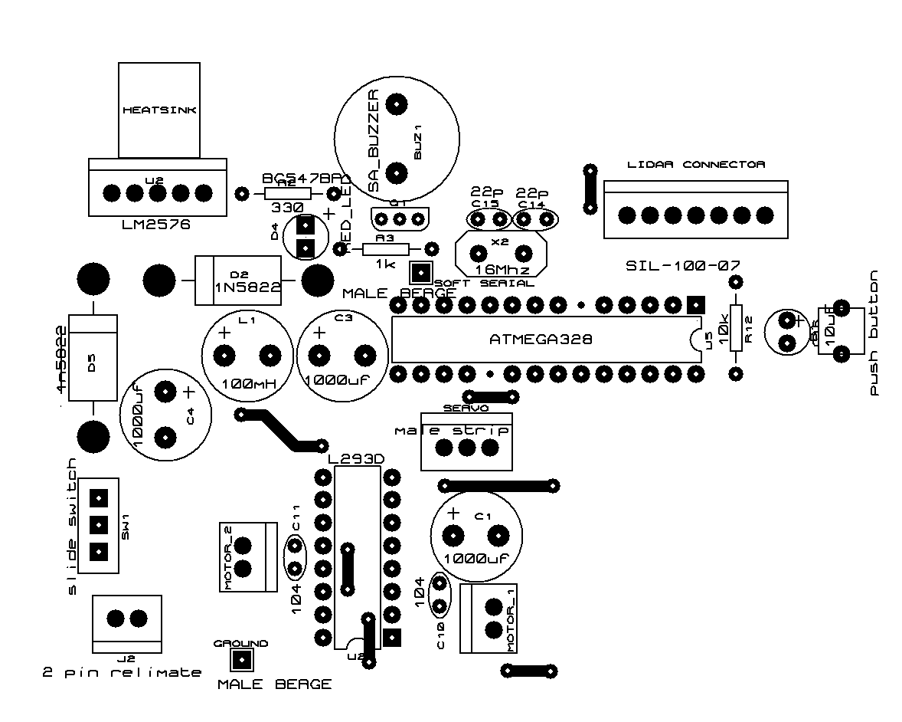
Layout Design of the LiDAR Control Unit

Slide 17
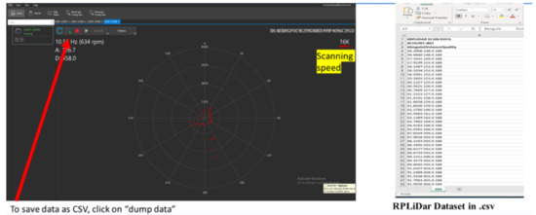
SLAMTEC ROBO STUDIO
With RoboStudio, developers can build communication with the robot and get the robot’s sensor data,pose, state, map information and other data via the interfaces provided by the robot.
After reprocessing the above collected data, RobooStudio can present it in a user-friendly interface. Developers can also monitor and control the robot visually by sending command to the robot via RoboStudio.

Slide 18
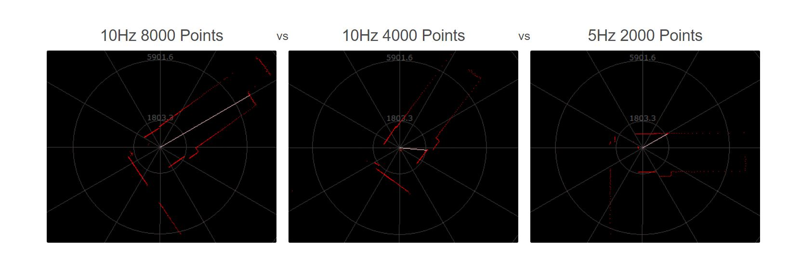
Variation of RPLiDAR in Different frequency

Slide 19
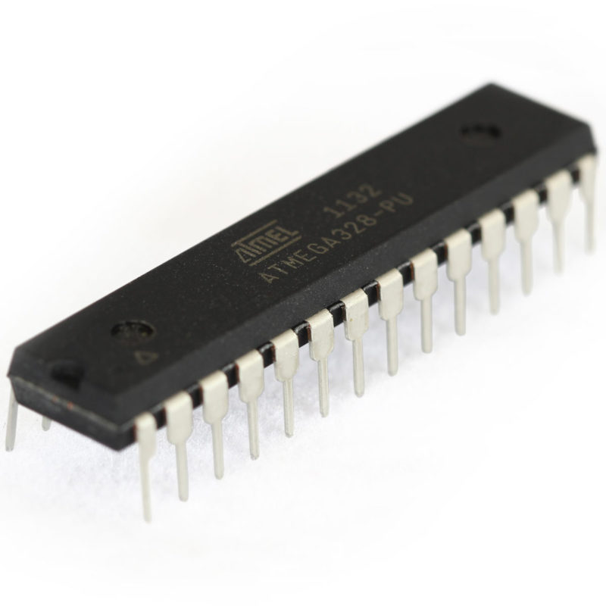
ATmega328P
ATmega328 is an eight bit Microcontroller. It can handle the data sized of up to eight bits. It is an AVR based miniaturized scale controller. Its built in interior memory is around 32KB.
It works extending from 3.3V to 5V. It has a capacity to store the information notwithstanding when the electrical supply is expelled from its biasing terminals.
Its brilliant highlights incorporate the cost effectiveness, low power dispersal, programming lock for security purposes, genuine clock counter with isolated oscillator. It's ordinarily utilized as a part of Embedded Systems applications

Slide 20
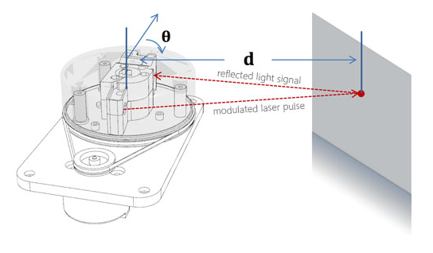
LiDAR
RPLIDAR A1 is a low cost 360-degree 2D laser scanner (LIDAR) solution developed by SLAMTEC. The system can perform a 360-degree scan within the 12-meter range (6-meter range of A1M8-R4 and the blowing models). The produced 2D point cloud data can be used in mapping, localization and object/environment modeling.
RPLIDAR A1’s scanning frequency reached 5.5 Hz when sampling 1450 points each round. And it can be configured up to 10 Hz maximum. RPLIDAR A1 is basically a laser triangulation measurement system. It can work excellent in all kinds of indoor environment and the outdoor environment without direct sunlight exposure.System connection RPLIDAR A1 contains a range scanner system and a motor system. After power on each sub-system, RPLIDAR A1 start rotating and scanning clockwise.

Slide 21
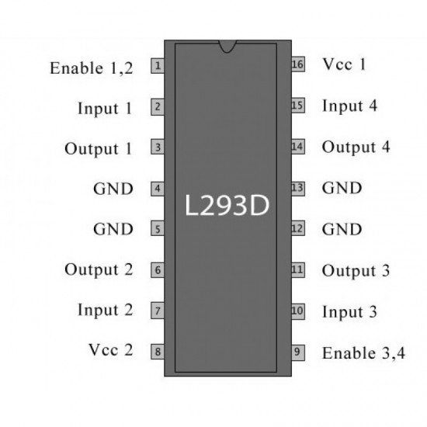
Motor Driver(L293D)
Motor drivers behave as amplifiers since they supply a higher-current signal and take a control signal. This greater sign is utilized to drive the motors.
L293D contains two driver circuits that are inbuilt. In its mode of operation, two DC motors can be driven simultaneously, both in forward and reverse direction.
Input logic can controls. two motors' motor operations at pins 2 & 7 and 10 & 15.
Logic 00 or 11 will stop the corresponding engine. 10 and logic 01 will rotate it in anticlockwise and clockwise directions.
Empower pins 1 and 9 (corresponding to the 2 motors) must be high for motors to start operating. When an enable input is high, the driver gets empowered. As a result, the outputs work with their inputs in phase and become busy. When the input is reduced, this driver is handicapped, and their outputs are off and at the high-impedance state.

Slide 22
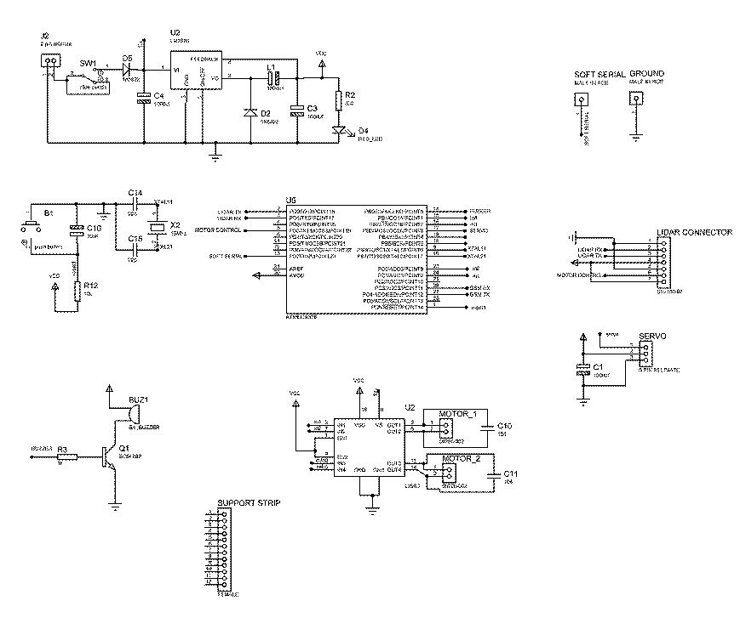
Working Model
Circuit Diagram Of Control Unit

Slide 23
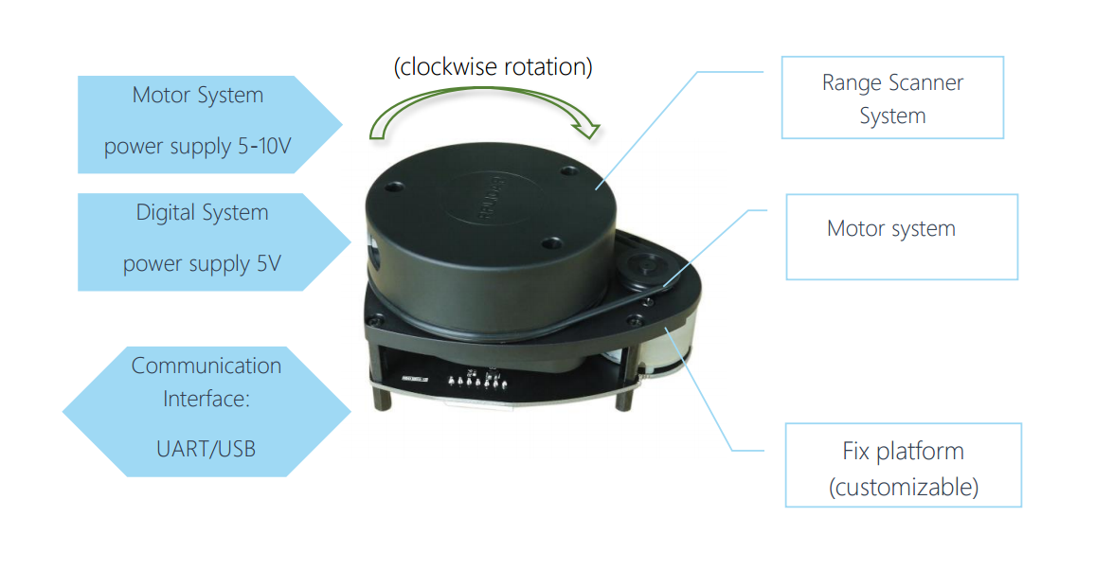
The Chassis is attached with LiDAR,four wheels and a control unit.Where the front wheels are connected to servo motor and back wheels are connected to DC motors.
According to the inputs of the LiDAR the logic (code) in the control unit starts excuting and sents the signal to the motors through the motor drivers.
The moving obstacles and the stationery obstacles are mapped according using SLAMTEC Robostudio.

Slide 24
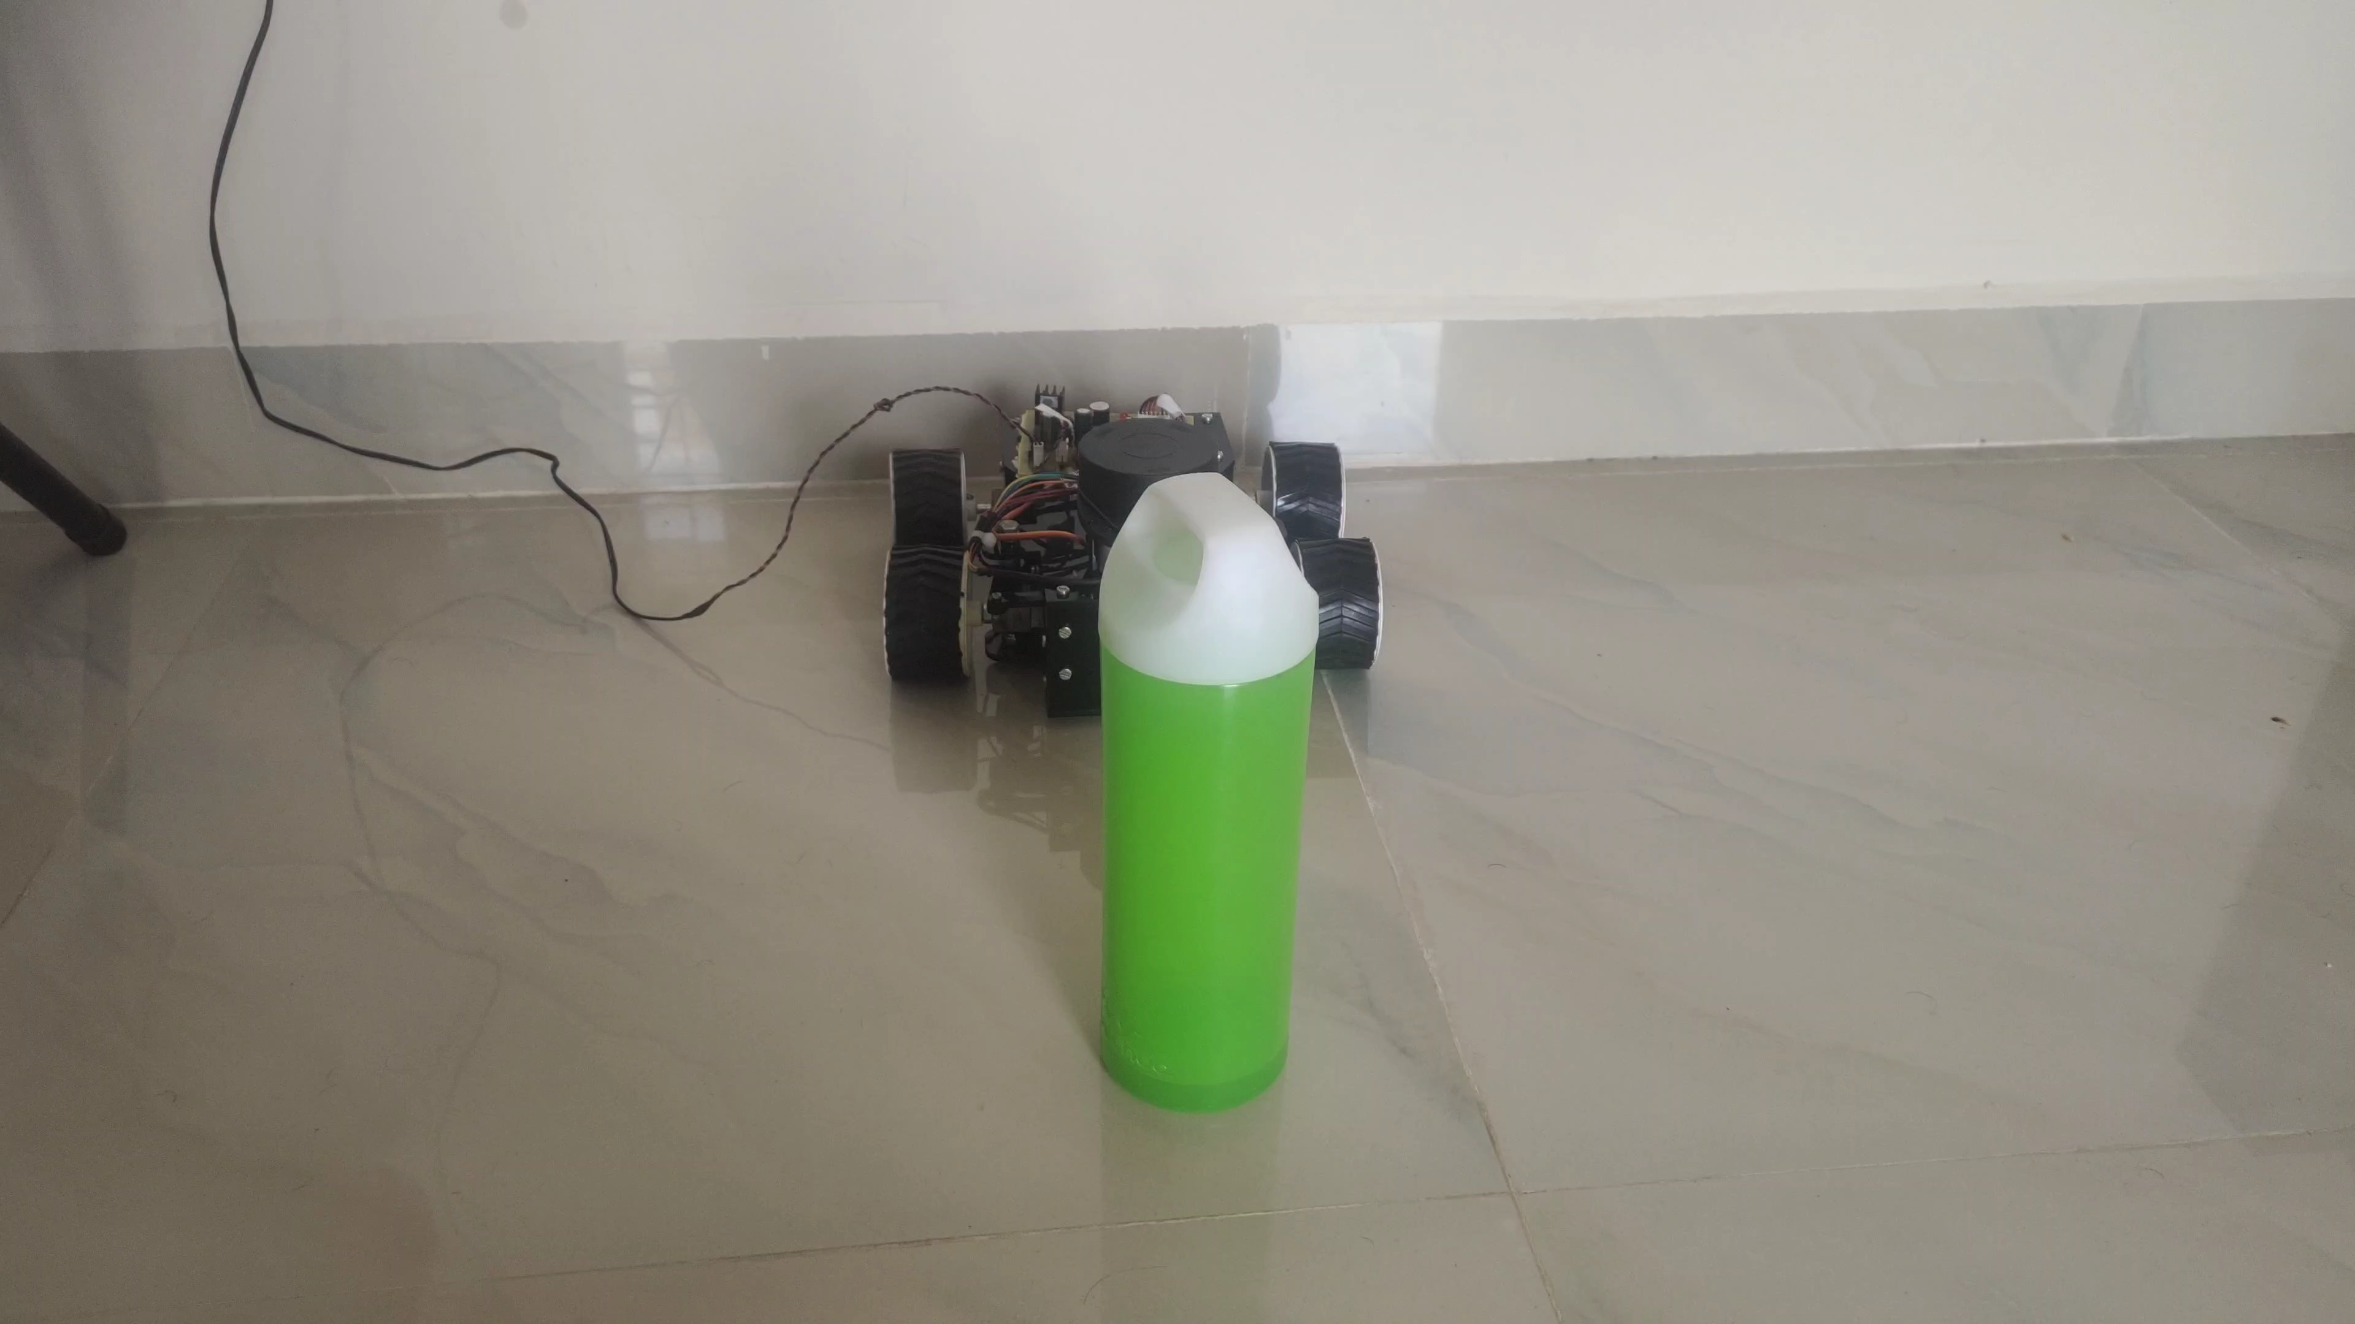

Slide 25
Conclusion
A multi-modal system for detecting, tracking and classifyingobjects in outdoor environment for LIDAR based self driving vehicle was presented.
According to the algorithm and combination of sensorgives the better results. Where LIDAR plays a vital role among the sensor.
Where it gives better environment presents for the vehicle.When an LIDAR based self driving vehicle is compared with a driver, it has to be updated accordingly to the environment change for the better performance.

Slide 26
Thank You

